Slide 1
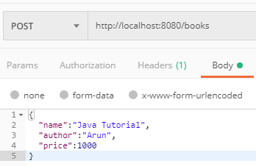

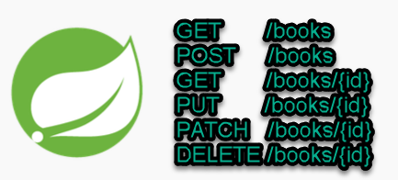
Spring boot - REST Validation Example - Custom Validator
Postman client
SpringBootDemo
DB
Consuming a RESTful Web Services by using Postman client
REST Endpoints to Create/Update/
Get/Delete book details

Slide 2
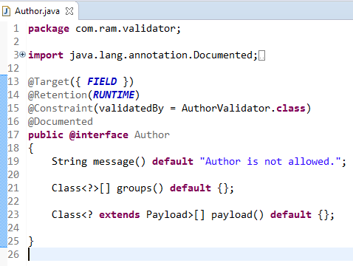
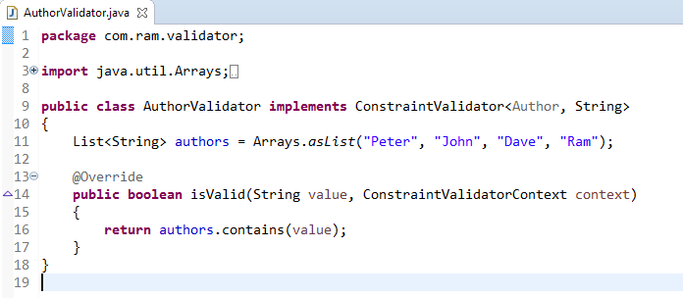
Spring boot - REST Validation Example - Custom Validator
1
We will create a custom validator for the author field, only allowing 4 authors to save into the database.
2

Slide 3
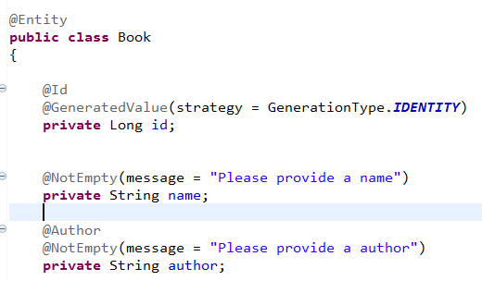
Spring boot - REST Validation Example - Custom Validator
If the custom validator is failed, it will trigger a MethodArgumentNotValidException
3

Slide 4
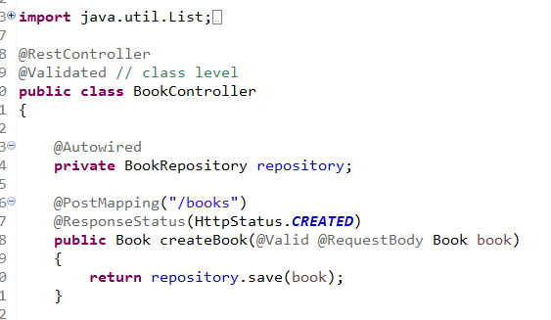
Spring boot - REST Validation Example - Custom Validator
4
Apply @Validated on class level, and add the javax.validation.constraints.* annotations on path variables

Slide 5
Default Validation
1. First add belo dependency in pom.xml file
<!-- https://mvnrepository.com/artifact/org.springframework.boot/spring-boot-starter-validation -->
<dependency>
<groupId>org.springframework.boot</groupId>
<artifactId>spring-boot-starter-validation</artifactId>
<version>2.3.3.RELEASE</version>
</dependency>
2. @Valid @RequestBody Product product // add @Valid on request body entity class
3. Add appropriate annotation on model class like @NotNull, @Size(Max=100)

